Slide 1

FITRE: Fisher Informed Trust-region Method for Training Policy Networks
Jan. 2021

Slide 2
What is Fisher Informed Trust REgion?
FITRE is a high order optimizer which can be used in training deep neural networks
Advantages of FITRE
Fewer tuning parameters
Fewer steps to reach higher reward
Scalable to large problem
How does FITRE achieve these?
Natural Gradient (vs. true gradient) as the descent direction
Simple trust-region style updates to model parameters
Modifications made to apply FITRE on reinforcement learning
Original FITRE algorithm is designed for supervised learning
We modified the algorithm to support reinforcement learning
FITRE now supports both continuous and discrete models
Notes:
Why Higher Order methods:
Most prevalent optimization methods in machine learning/big data space heavily rely on first-order methods. First-order methods rely on (true) gradient as the descent direction when
Optimizing an objective function. The most important hyper-parameter, which is step-size, is either approximated or pre-defined schedule is used to update it dynamically. Because of this,
Resources used for training the model can explode depending on the hyper-parameter space. In addition, gradient vanishes around saddle points making first-order methods vulnerable when
Navigating around saddle points. First-order methods are also know to be very sensitive w.r.t hyper-parameter tuning. However, computing gradient is a trivial computation task even for significantly
Large models making them heavily used methods for optimization. Stochastic first order methods, where model parameters are updated for every mini-batch, are heavily used for training
Large models and the inherent noise present in the gradient (computed using mini-batch) helps them converge to a local minima.
Second order methods, remove a the most significant bottleneck during training by removing the guess work in updating the step-size when updating the model parameters.
The model parameter update becomes [ Hessian^{-1} * gradient ]. Note that each component of the gradient is scaled individually as opposed to a constant used in first-order methods.
Higher order methods are known to resilient adverserial conditions of the problem, for instance problem ill-conditioning. Fewer hyper-parameters reduce the training time significantly
Compared to first order methods. Are well suited to navigate around saddle points, steep and shallow regions of the function manifold. However, second-order methods rely on computation
Of higher order statistics (Hessian or similar) making them significantly expensive in terms of computation cost.
Fisher Informed Trust REgion
A higher order method to train deep neural networks. It can be adopted to both continuous and distributed parameter space.
It uses Natural Gradient ( which is the true descent direction in the distribution space for non-convex objective functions) and is defined as “-1 * Fisher Inverse * gradient.
Computing Fisher matrix (which is defined as Ex[ gradient * gradient^{T} ] ) is intractable for problems in big-data space where the model parameters are >> 1
Recent approximation method, Kronecker Factored Approximated Curvature (K-FAC), is used to compute the Fisher matrix (and resulting natural gradient)
Step size is estimated using a 2nd order Taylor series approximation along the direction of natural gradient and controlled by the trust-region around the current iterate.
In the context of reinforcement learning the role of a given optimizer becomes very significant.
Training dataset is not available beforehand as in the case of supervised learning problems
Optimizer has to interact with the environment to generate sample points for training on the fly
Any reduction in the number of these interactions will have significant benefits, like appropriate reduction in training time

Slide 3
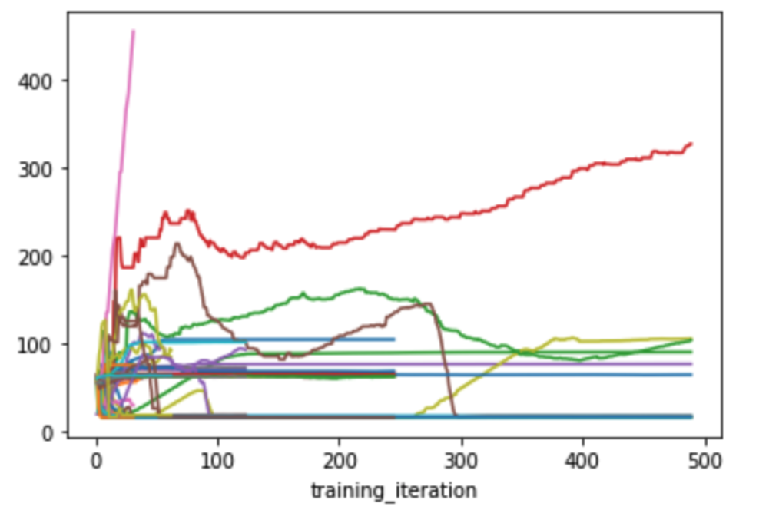
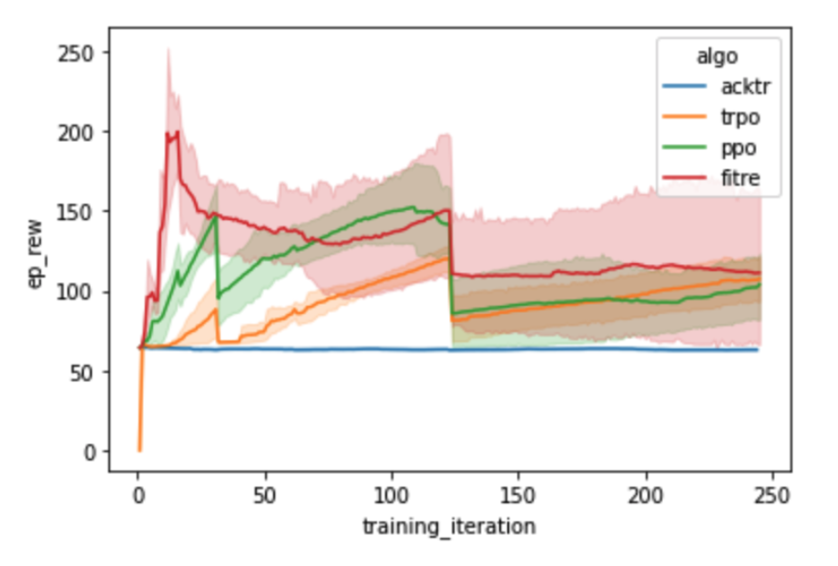
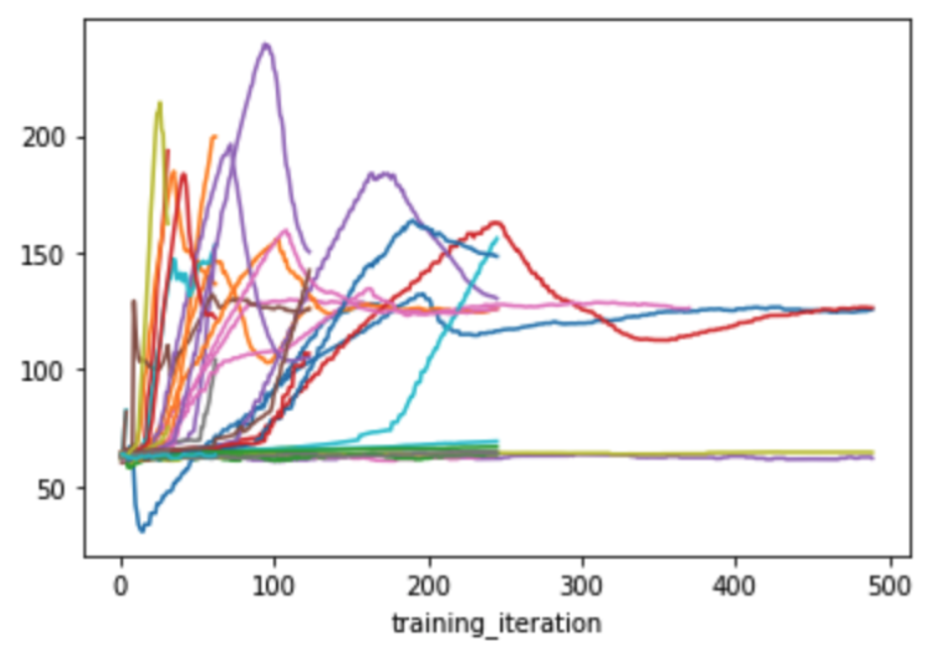
Comparison and demo on F16
FITRE plot
Top-5 plot of different methods
Simulation
The following is a 20 seconds simulation of the F16 model. The plane is controlled by a neural network trained by FITRE.
FITRE
PPO
PPO plot
Conclusion:
FITRE achieved highest reward using fewest iterations
FITRE policy pulls the F16 faster than PPO policy
Notes:
(Left Plots)
We run 50 trials for each optimization method. Trajectories in the left two plots (FITRE plot & PPO plot) show rewards of one trial at different iterations. The higher the reward the better.
FITRE: highest reward is around 450 achieved within about 30 iterations (pink trajectory)
PPO: highest reward is around 280 achieved within about 90 iterations (purple trajectory)
(Middle Plot)
Trajectory in the middle plot (Top-5 plot of different methods) represents the mean of top five rewards of each algorithm, while the shade represents derivation.
(Right GIFs)
Compare to the simulation of PPO, FITRE is much better as it pulls up earlier at a higher altitude.

Slide 4
Thank you
Q & A

Slide 5
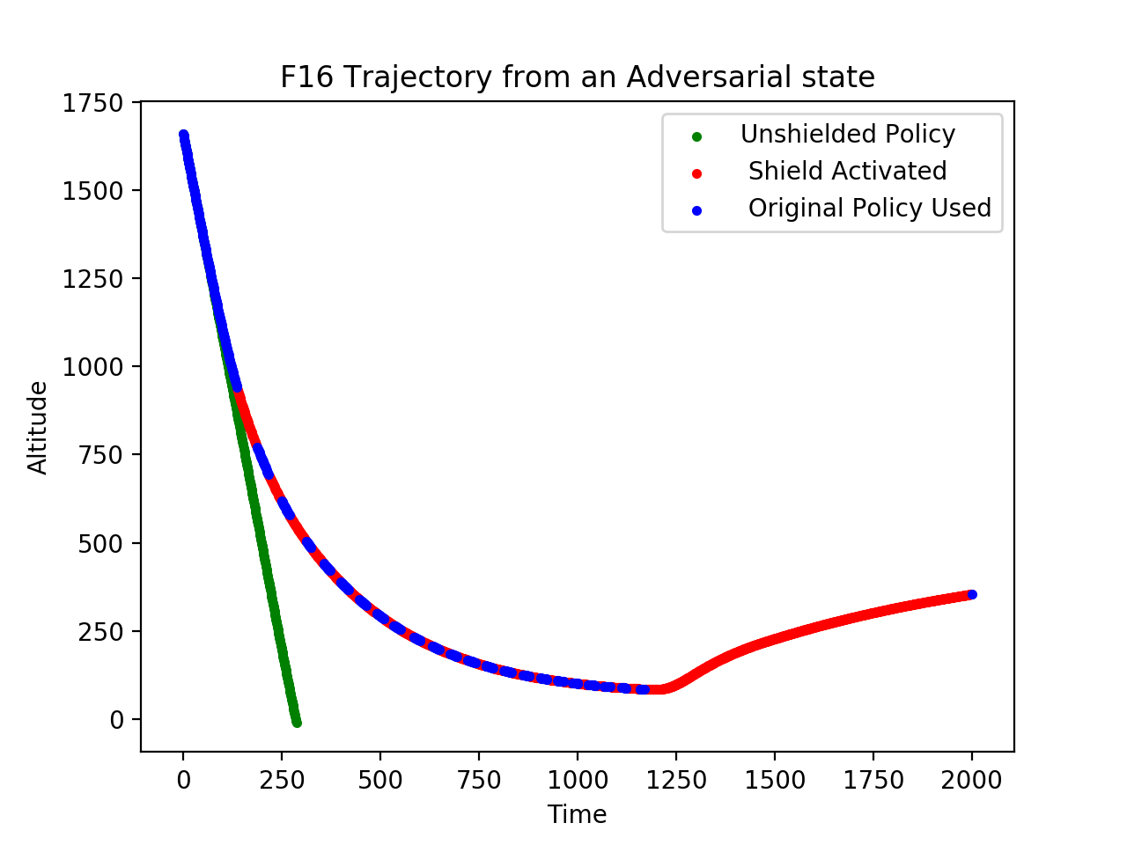
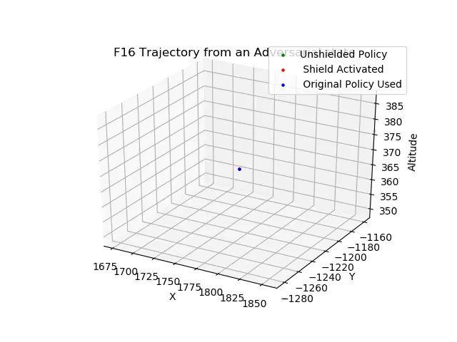
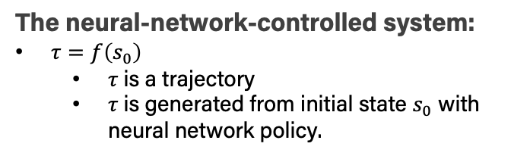
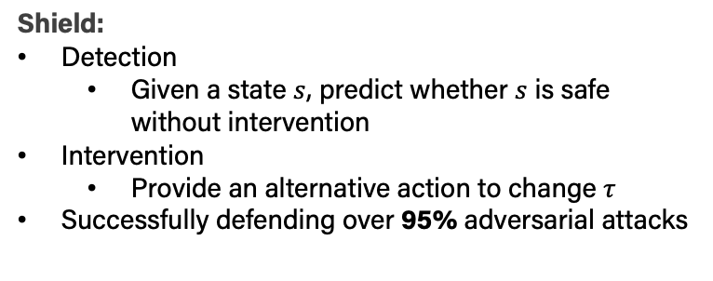
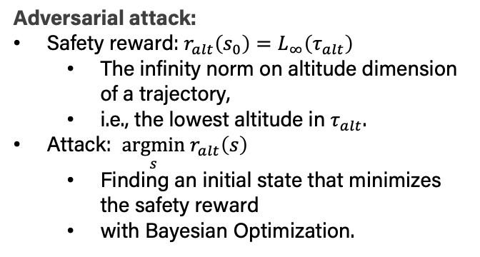
Adversarial Attack and Shield
The neural-network-controlled system:
$τ=f\left(s_{0}\right)$
$τ$is a trajectory
$τ$is generated from initial state $s_{0}$ with neural network policy.
PPO trajectories with and without shielding at an adversarial state
Adversarial attack:
Safety reward: $r_{alt}\left(s_{0}\right)=L_{∞}\left(τ_{alt}\right)$
The infinity norm on altitude dimension of a trajectory,
i.e., the lowest altitude in $τ_{alt}$.
Attack: $\underset{s}{argmin} r_{alt}\left(s\right)$
Finding an initial state that minimizes the safety reward
with Bayesian Optimization.
Shield:
Detection
Given a state $s$, predict whether $s$ is safe without intervention
Intervention
Provide an alternative action to change $τ$
Successfully defending over 95% adversarial attacks
Without shielding, initialize the F16 with an adversarial state will lead to the crash.
Docker available: https://hub.docker.com/repository/docker/caffett/neural_shield

